Slide 1
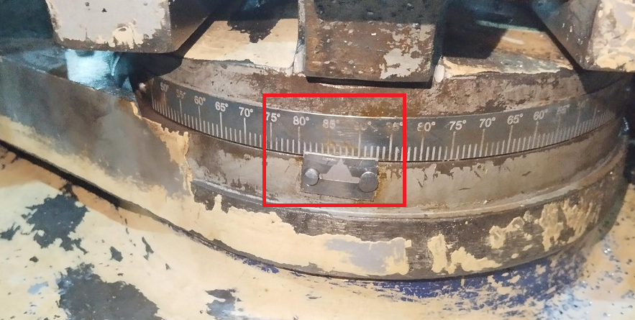
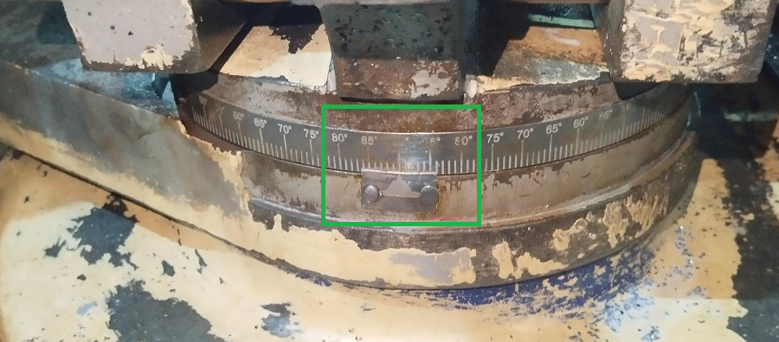
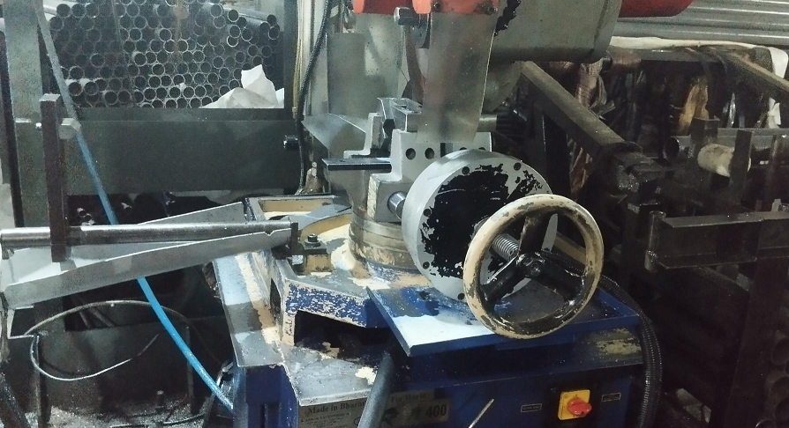
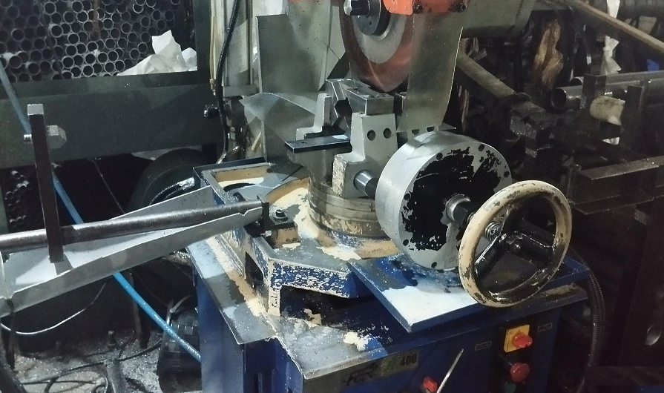
ACTION EVIDENCIES - OCCURRENCE
BEFORE
AFTER
Setting adjuster lever
Setting adjuster lever removed
Cutting Blade Head angle 87.5 Deg. against req. 90 Deg
. Cutting Blade Head angle set to 90 Deg & Setting adjuster leaver removed from Machine

