Slide 1
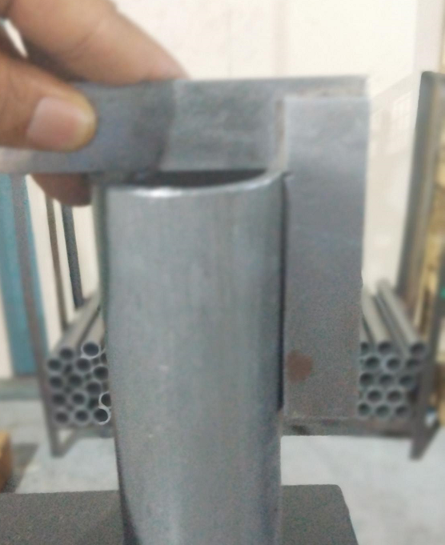
ACTION EVIDENCIES – Inspection Side
BEFORE
AFTER
No Inspection for Cutting Tapper (Inspect Length on Surface table at 04 Points of Tube Face by resting tube on surface Table)
. No Inspection for Cutting Tapper
. Right angle is using for inspection on sampling basis. Quality Alert Displayed at Final Inspection

Slide 2
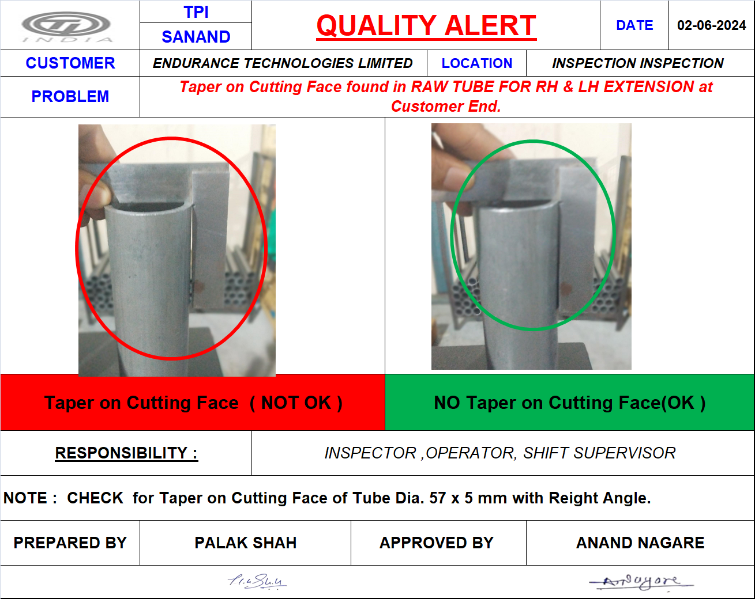
ACTION EVIDENCIES – Inspection Side

