Slide 1
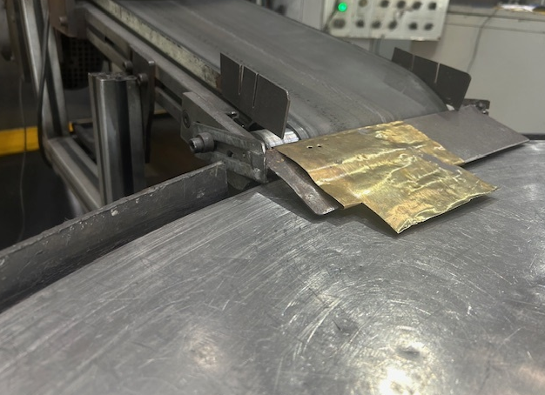
Before : Excess Gap on Rotary Table

