Slide 1
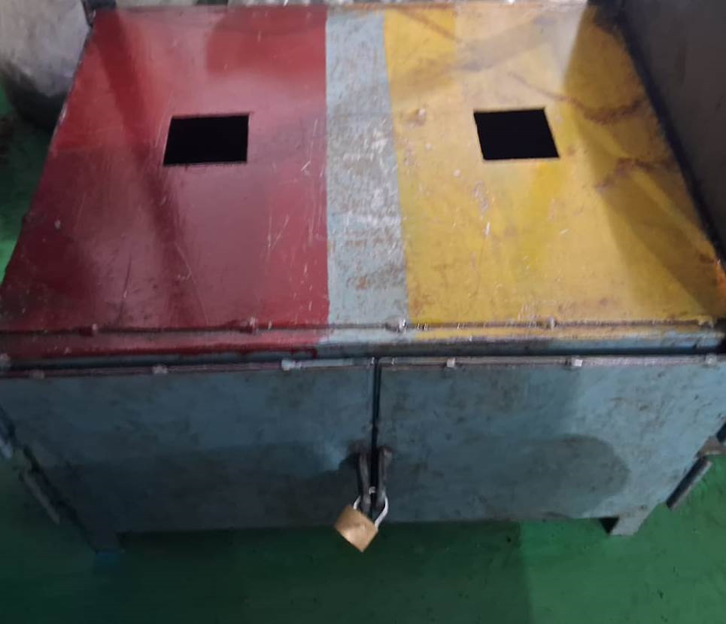
Countermeasure:- Detection Side
EVIDENSES
FINAL INSPECTION: ‘Q’ GATE
BEFORE
AFTER
Problem/Present Status:
lock and key not available at MPI testing supplier (Outsource)
Countermeasure:
Lock and key provided for NG material at MPI testing supplier.

