Slide 1
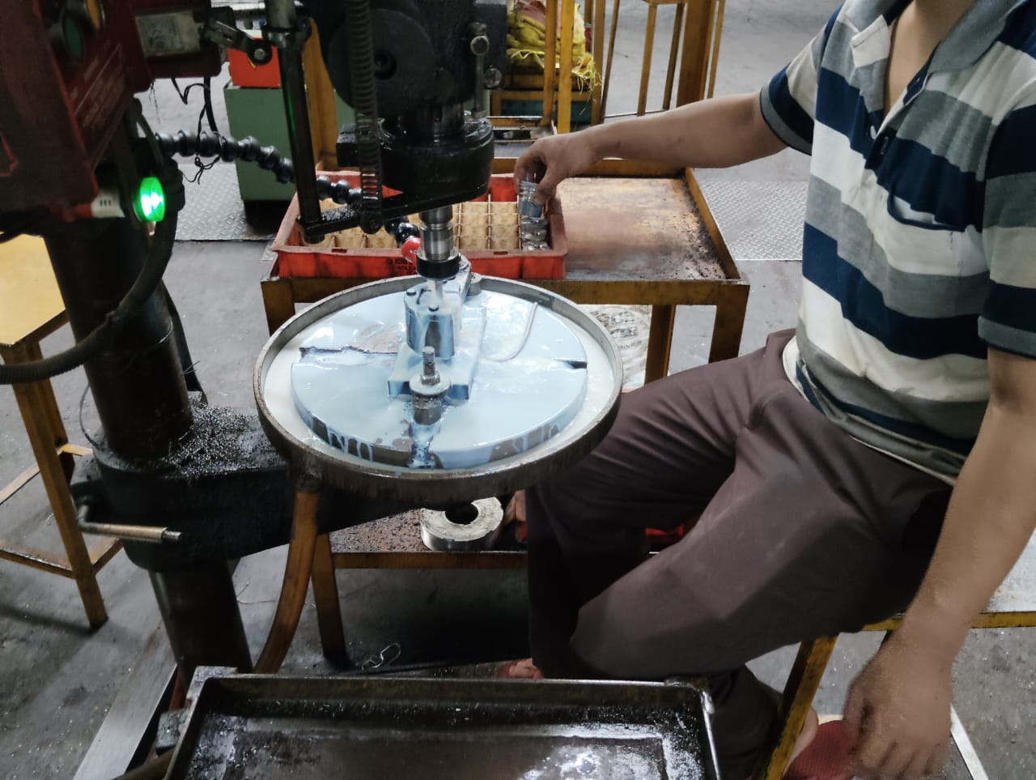
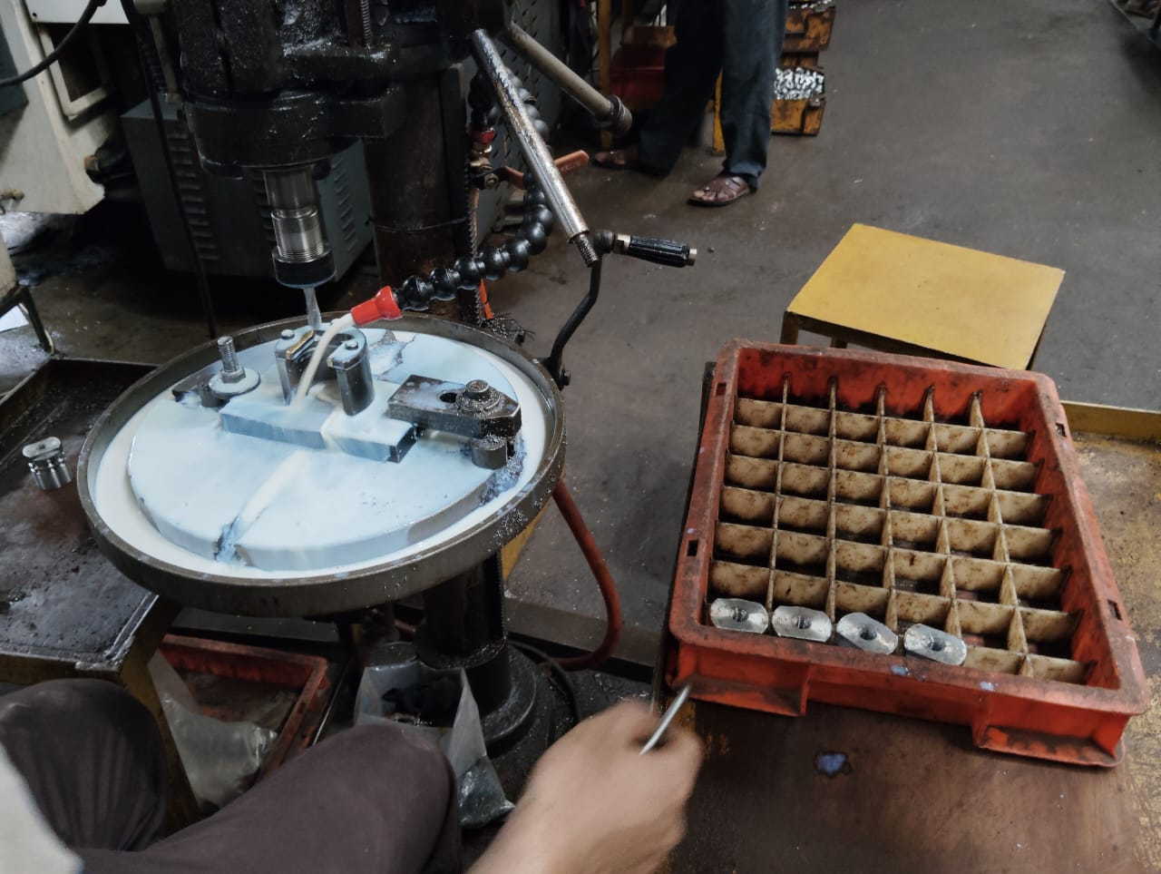
Action Plan Evidences
OCCURRENCE SIDE- AFTER
Operator is keeping finished material in out Put bin.
No Material is Kept on Machine
Training and Instructions given to operator not to keep input and output Material on Machine to avoid Mix-up of Material.

