Slide 1
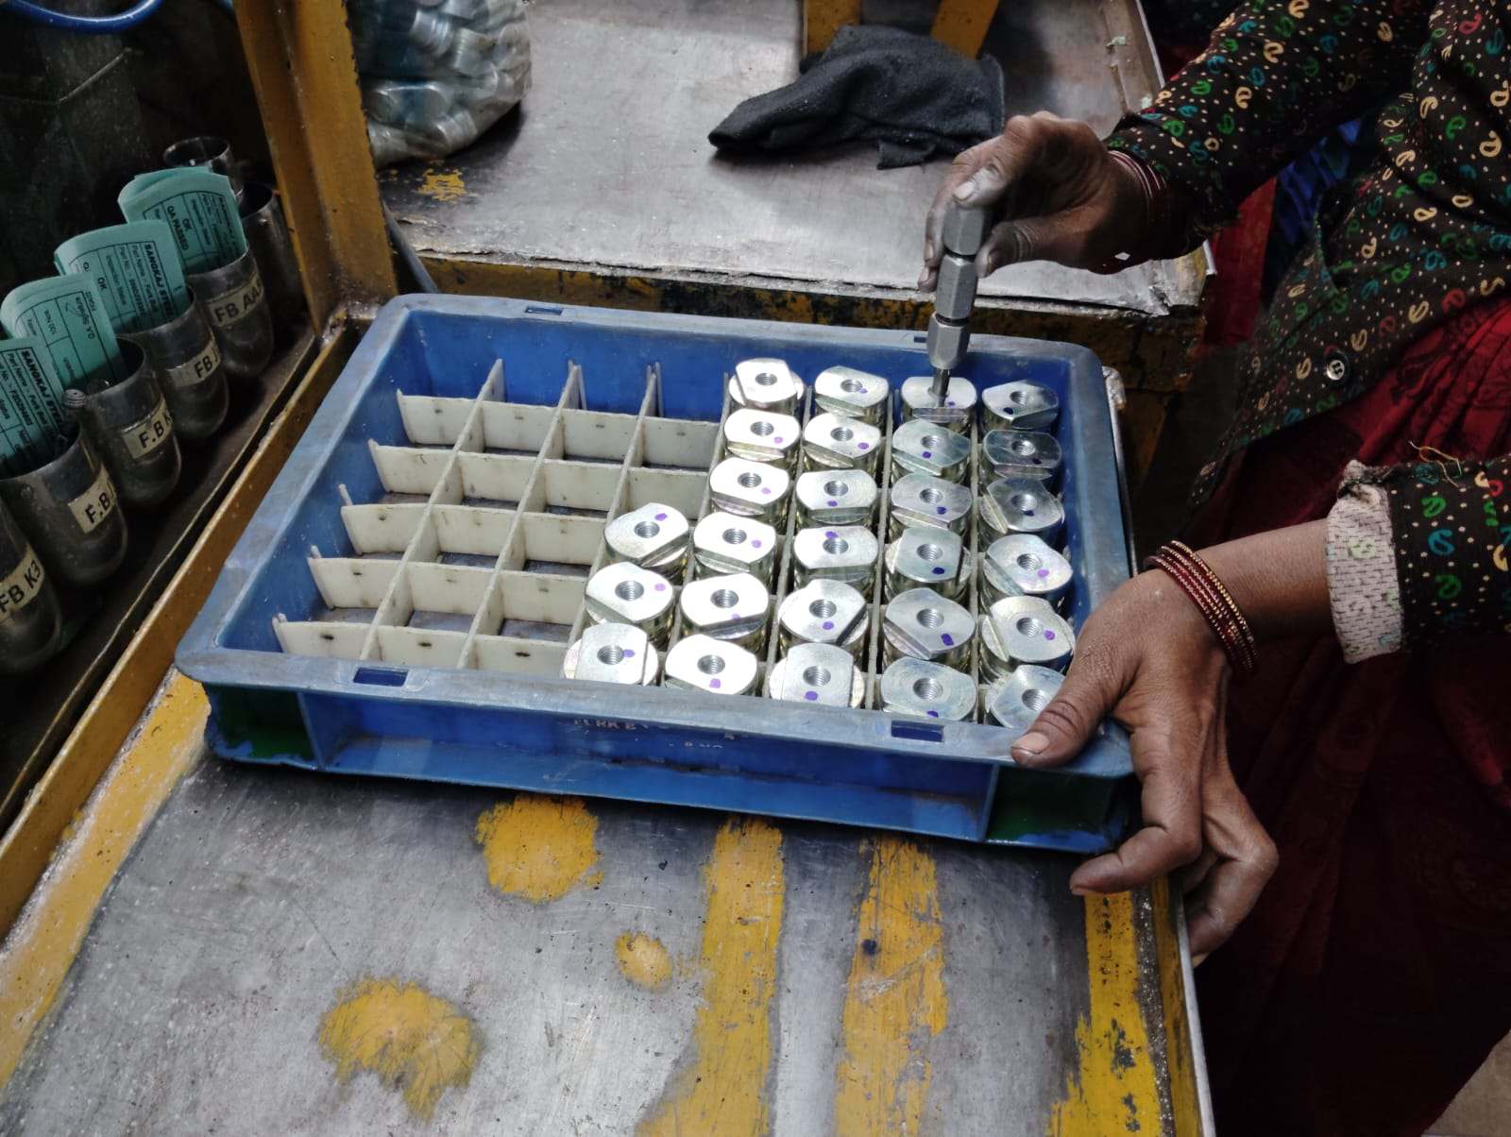
Action Plan Evidences
OUTFLOW - AFTER
100% Inspection of Threading minor Diameter with Minor Diameter No-Go PPG. This will Arrest the operation missing Part.

Slide 2
Action Plan Evidences
OUTFLOW - AFTER
Q-Alert
Inspection Standard Updated

