Slide 1
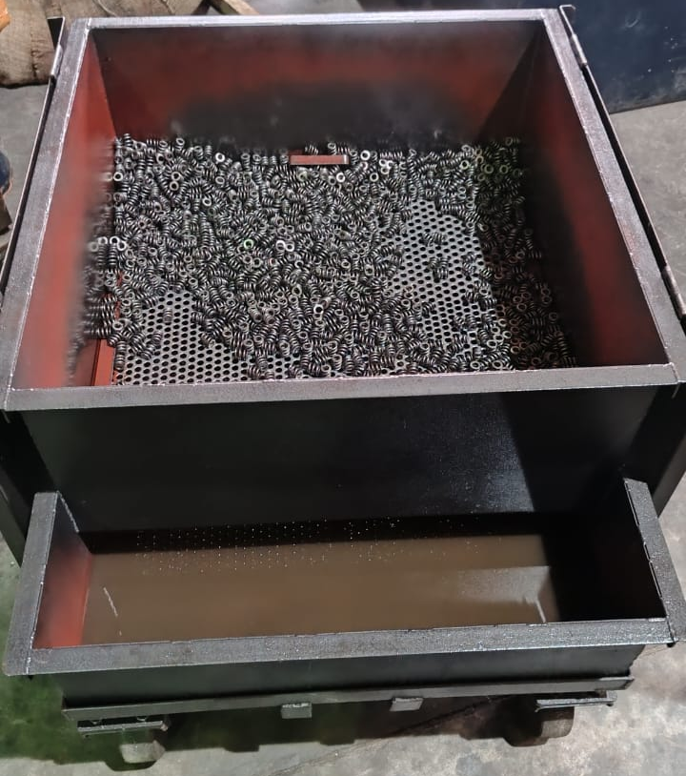
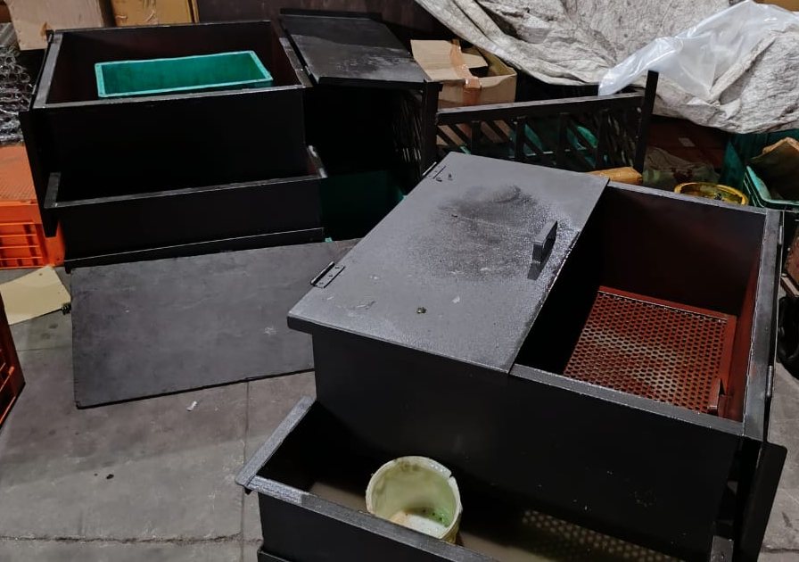
Sagar Springs Pvt Ltd
O.P.L (One Point Lesson)
Basic Knowledge: | Improvement Case: √ | Trouble Shooting Case:
OPL Theme: To prevent mix up of other model springs | Lesson No: 190 | Date: 30.06.2024
Before | After
Impact: * One oiling tray available for oiling all models of rebound springs (similar looking springs) caused mix up | Corrective Action: * Two more oiling trays arranged to oil similar looking springs separately and prevent mix up

