Slide 1
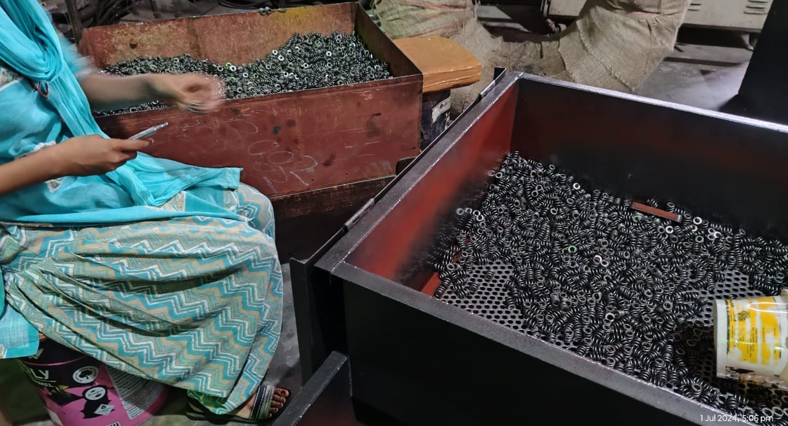
Sagar Springs Pvt Ltd
O.P.L (One Point Lesson)
Basic Knowledge: | Improvement Case: √ | Trouble Shooting Case:
OPL Theme: To prevent mix up of other model springs | Lesson No: 191 | Date: 30.06.2024
Before | After
Impact: * After final inspection oiling and packing as per packing plan | Corrective Action: After final inspection immediately oiling, packing without delay to prevent mix up

