Slide 1
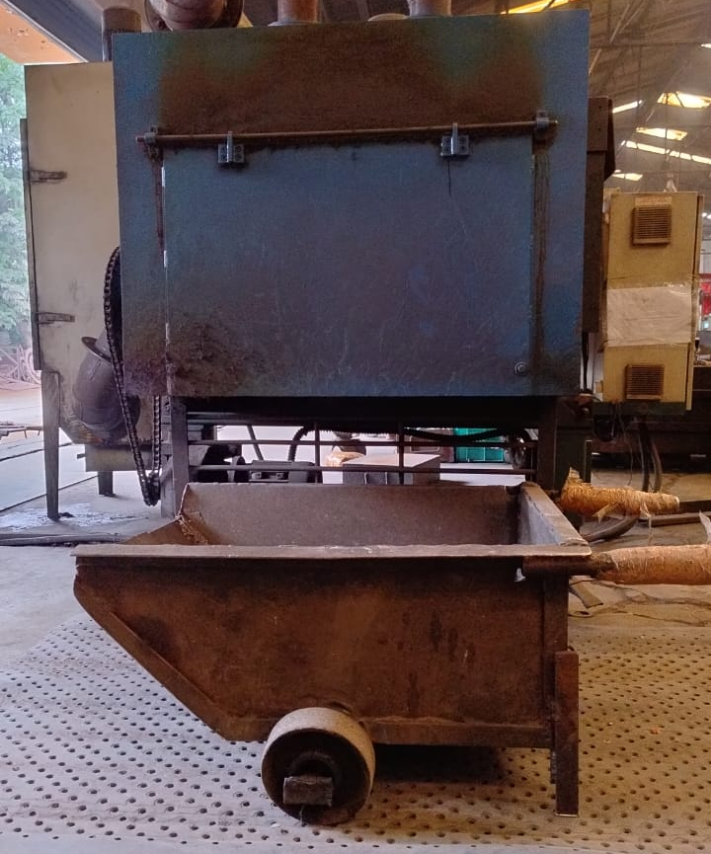
Sagar Springs Pvt Ltd
O.P.L (One Point Lesson)
Basic Knowledge: | Improvement Case: √ | Trouble Shooting Case:
OPL Theme: To prevent Spring Bend | Lesson No: 192 | Date: 30.06.2024
Before | After
Impact: * Material handling trolley design constraint causing spring bend during unloading springs | Corrective Action: Trolley design modified to prevent spring bend issue

