Slide 1
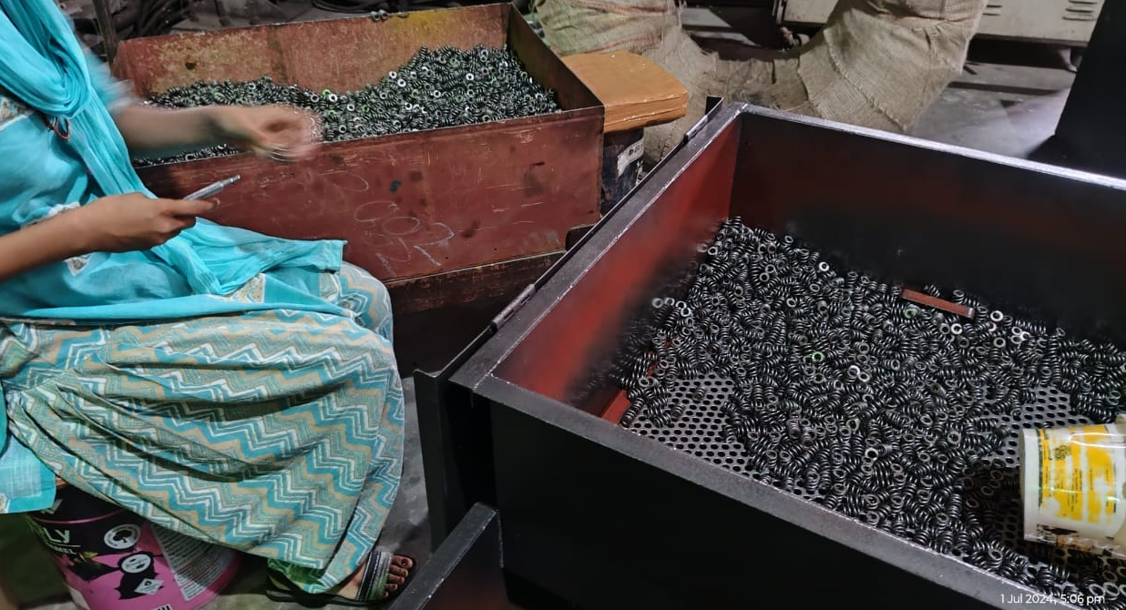
Sagar Springs Pvt Ltd
O.P.L (One Point Lesson)
Basic Knowledge: | Improvement Case: √ | Trouble Shooting Case:
OPL Theme: To prevent Spring Bend | Lesson No: 193 | Date: 30.06.2024
Before | After
Impact: * At final Inspection sampling inspection followed caused non detection of spring bend | Corrective Action: After final inspection visual inspection before coiling to detect spring bend issue

