Slide 1
Casting Crack Issue of K0LA COUNTERMEASURE
Dekson Casting Limited

Slide 2
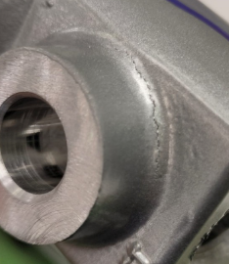
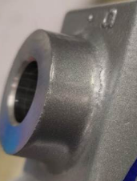
CONDITIONS FOR OCCURRENCE
● Phenomenon: Casting Crack
・Customer- Endurance Technologies Ltd. Narsapur
・Model- K0LA drum LH
・Parts name- Outer Tube
・Qty NG- 118 No Each
●K0LA Parts Stock check results
Action
Area | Total Stock | Checked | Checking Method | NG Qty | Status
Dekson Final Stage | 528 | 520 | Visual | 8 | OK
Dekson VMC Stage | 422 | 418 | Visual | 4 | OK
Dekson Casting Stage | 516 | 510 | Visual | 6 | OK

Slide 3
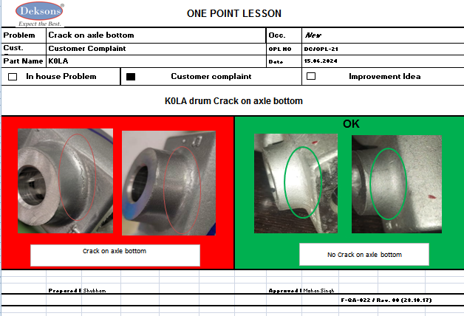
Q- Alert

Slide 4
UNDERSTANDING OF ACTUAL CONDITION AND CONTROL
K0LA Outer Tube Process Flow
1
2
Receipt of ingot
Melting
Degassing
Casting
Cutting & fettling
GDC Q-Gate
SPM
3
Final Inspection and Dispatch
BUFFING
BTA Machining
VMC Machining
Possible defect occurrence area.
Possible defect detection area.

Slide 5
UNDERSTANDING OF ACTUAL CONDITION
● Understanding the actual cause – (Factor analysis)
Man
Machine
Unskilled operator & inspector
Wrong inserted water cooling pipe
Less awareness
Crack observed on axle bottom
Die temperature Variation
Chemical composition not ok
Catching
Metal temperature high / low
Method
Material

Slide 6
FACTS VERIFICATION
Sr No. | 4M | PROBABLE CAUSES | FACTS VERIFICATION | Judgment
1 | MAN | Unskilled operator | Skilled operator deputed at particular stage | O
 |  | Less awareness | verify Awareness of operator and found Not Ok | X
2 | Machine | Wrong inserted water cooling pipe | Chilling pipe location as per process bottom side. (axle side area) | X
3 | Method | Die temperature Variation | Die temperature found within specification. | O
 |  | Metal temperature high / low | Molten metal temperature observed as per specification | O
 |  | Catching | Due to hotspot area creation casting get catching defect. | X
4 | Material | Chemical composition not ok | Chemical composition found as per specification | O
Legend:- O- OK X-Not OK ∆ - Improvement

Slide 7
ROOT CAUSE ESTABLISHMENT COUNTERMEASURES
(WHY-WHY ANALYSIS)
 | WHY-1 | WHY-2 | WHY-3
Occurrence Side | Crack observed in K0LA Outer Tube | Catching on part | Centre location -Wrong inserted chilling pipe
Detection side | Crack observed in K0LA Outer Tube | Not detected in Inspection | Oversight
● Conclusion: The operator incorrectly placed the chilling pipe in the centre of the die, so the bottom side of the part did not cool properly, resulting in a crack.

Slide 8
COUNTERMEASURES
Countermeasures:
Cause | Countermeasure | Tgt. Date | Status
<Occurrence > | Cooling pipe should be on bottom side verify by Supervisor and QA Engineer during every shift. Chilling pipe location, SOP displayed at concern location. Awareness Training Provided to Concern Person. | 15.06.2024 | Completed
<Detection> | Magnification Glass is Mounted on GDC Q Gate. Awareness Training Provided to Concern Person | 15.06.2024 | Completed

Slide 9
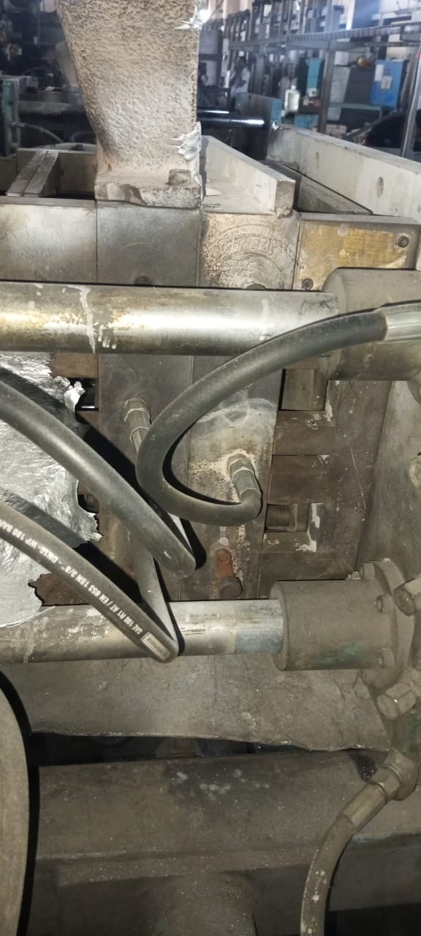
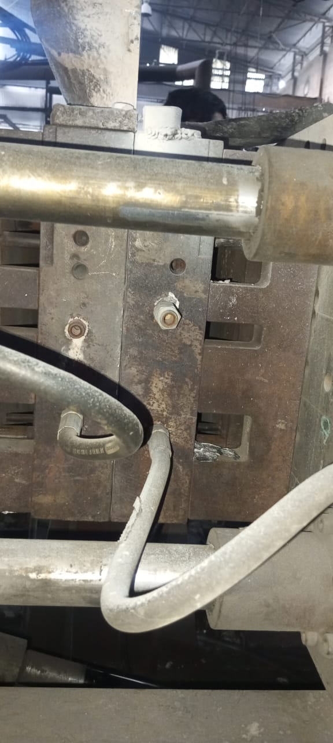
IMPROVEMENT ACTIONS
Shop : GDC
Date of Implementation:15.06.2024
Operation :
BEFORE
AFTER
Chilling pipe inserted to middle side
Chilling pipe inserted to bottom side

Slide 10
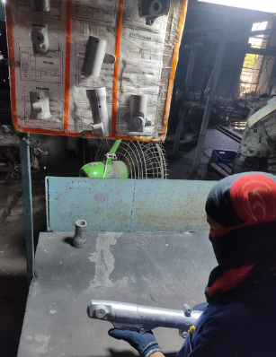
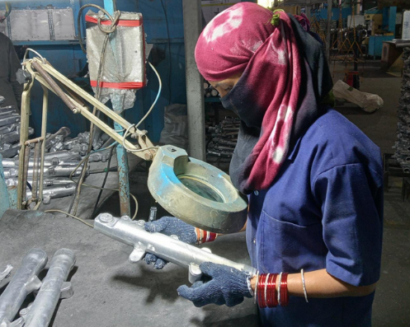
IMPROVEMENT ACTIONS
Shop : GDC
Date of Implementation:15.06.2024
Operation : Q Gate
BEFORE
AFTER
Inspection done by Visual as Per limit sample
Magnification Glass is Provided to Arrest defect
Problem/Present Status:
Inspection done by Visual as Per limit sample but chances of Minor defect skip
Countermeasure:
Additional Magnification Glass is Provided to Arrest all casting defect

Slide 11
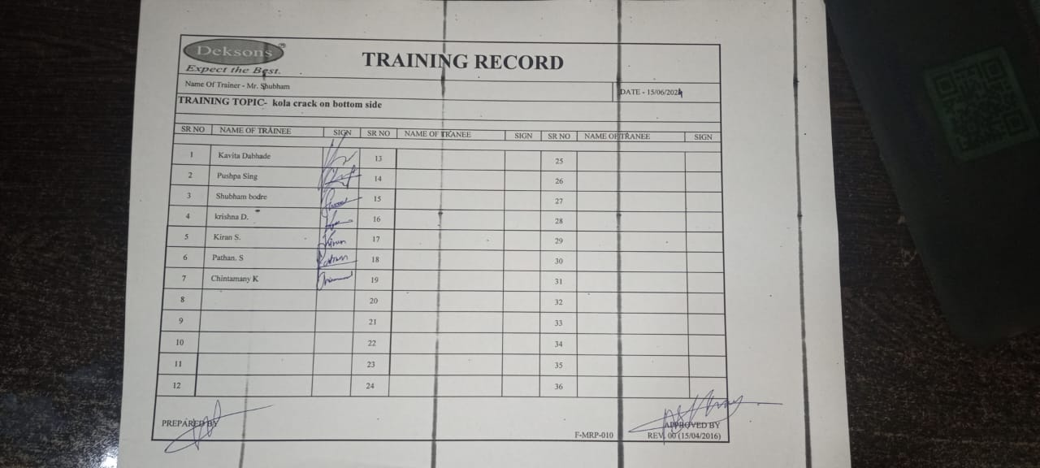
IMPROVEMENT ACTIONS- Customer Complaint Awareness Training
Shop : GDC, VMC, Final
Date of Traning:15/06/2024
Operation : Production & Quality

Slide 12
THANK YOU

