Slide 1
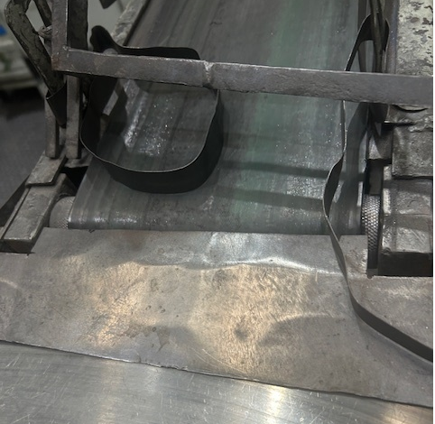
After : Gap Closed on Rotary Table

