Slide 1
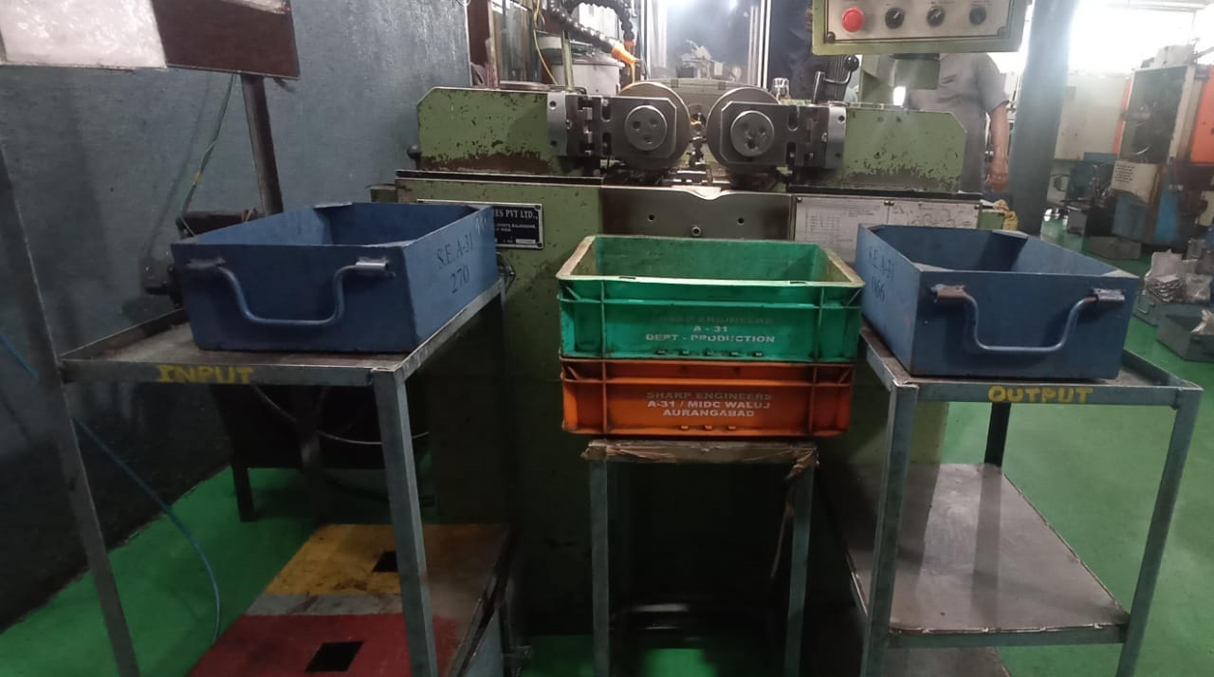
Countermeasure:- Occurrence Side
EVIDENSES
M/C Shop: Thread Rolling Machine
BEFORE
AFTER
Problem/Present Status:
Input and output separate table not provided
Countermeasure:
Input and output table provided separately for thread rolling machine

