Slide 1
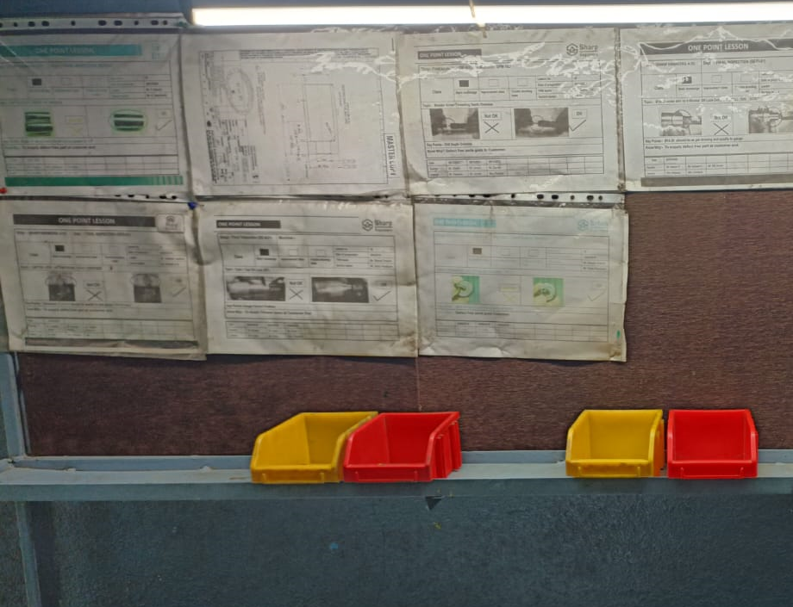
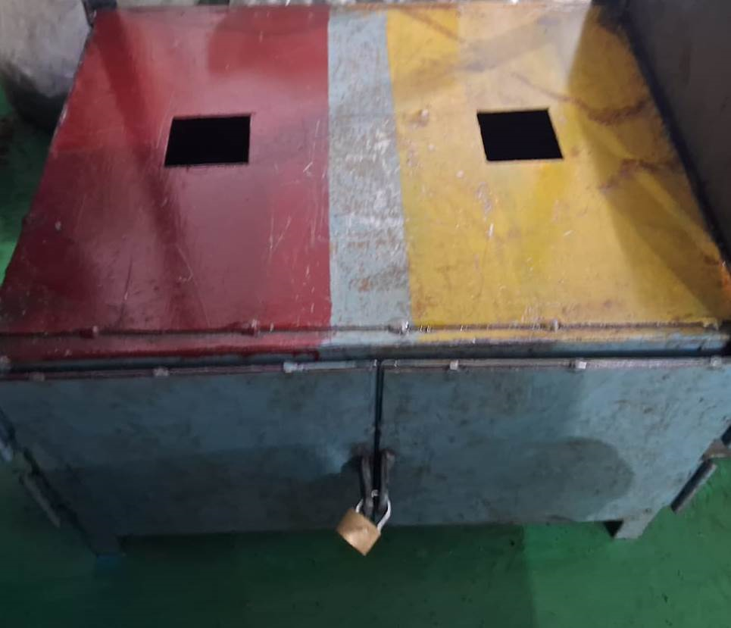
Countermeasure:- Detection Side (Outflow)
EVIDENSES
FINAL INSPECTION: ‘Q’ GATE
BEFORE
AFTER
Problem/Present Status:
Lock and key not available at final inspection stage red and yellow open provided.
Countermeasure:
Lock and key provided for NG material at final inspection stage for NG component storage.

