Slide 1
ENDURANCE TECHNOLOGIES
ACTION PLAN

Slide 2
Action plan
Sr. No. | When | What |  | Which |  | Where | How many | Why | Corrective action |  |  | Who | When | Status
 |  |  |  | Part No | Part Name
 |  | Customer Complaint | Defect Phenomenon
1 | 27.06.24 | Fitment not ok | Thread itching | B2DD005260 | Banjo Bolt | ETL | 8400 | Insp side: W1: Sampling inspection as per sampling plan Cause side: W1: Fitment not ok W2: More plating deformation in threads W3: Itching for thread area and un uniform plating for thread are W4- In proper cleaning for heat treatment scale for thread area | Insp Side: 100% visual inspection and fix the lady inspector for this part Cause side: 1.Acid pickling tank add inhibitor(Inhibitor to minimize the attack of the base metal) |  |  | SCA Jaikishan | 28.06.2024 04.04.2024 | C C
Sustenance action |  | Target date | Status | Preventive action |  | Tgt date | Status | System action | Tgt date | Status
QA Alert display |  | 27.06.2024 |  | Minimise the loading weight from 60 kgs to 50 kgs |  | 04.04.024 | IP | N/A

Slide 3
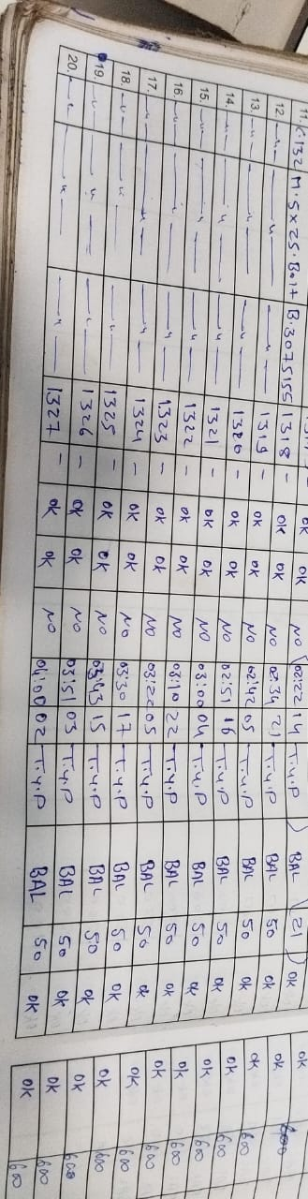
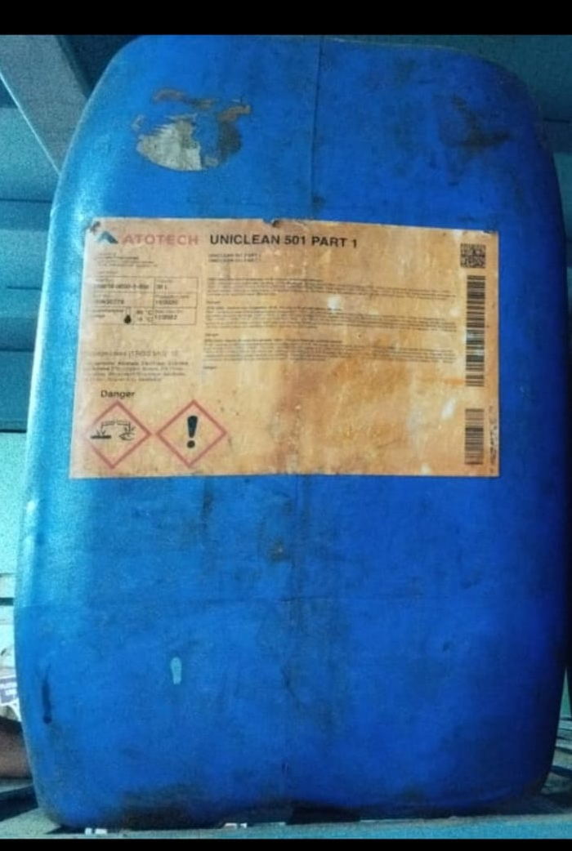
Action plan
Acid pickling tank add inhibitor(Inhibitor to minimize the attack of the base metal)
Minimise the loading weight from 60 kgs to 50 kgs

