Slide 1
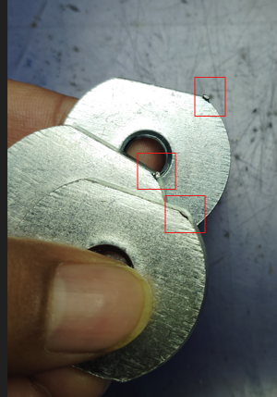
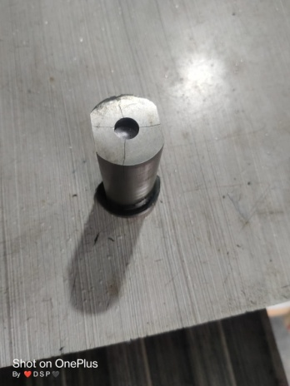
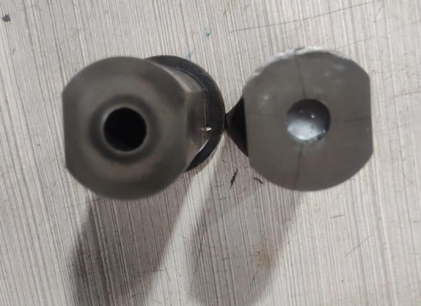
Action and Implementation
Not Ok part
Before
After
Not Ok TOOL Punch
Ok TOOL Punch
Part Name | Part No | Supplier | Defect | Actions | T. Date | Status
D nut KOLA | S1CW00512 | SAPTAGIRI ENGINEERING PVT. LTD. | Defect Phenomenon – Sharp Edge / Notch ( 15-07-2024 ) Why 1 : Part gets Sharp Edge at corner :Why 2: No clear Punch Cut at Blanking Why 3: Punch having Cut mark itself Root Cause: Punch not ok | Containment action: 100 % material verified at ETL and Saptagiri End Inspection side action: 1- Give awareness to Inspector. Cause Side Action: 1 Die Punch wear out 2 Make OK die punch 3 at Every set up size of Die punch verifies | 23.07.2024 | Completed
Prepare by : M/s. Saptagiri Engieering pvt.ltd.

