Slide 1
ACTION EVIDENCIES
Quality Alert

Slide 2
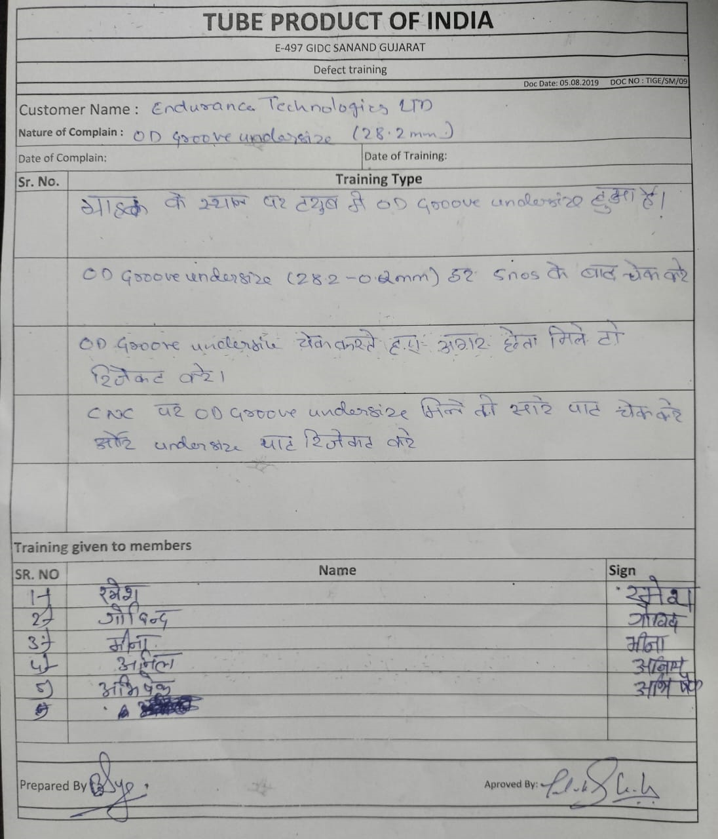
ACTION EVIDENCIES
Training Report

