Slide 1
Action Plan Evidences
Fork Bolt K86A-Gap in Fork Bolt and Fork Pipe.

Slide 2
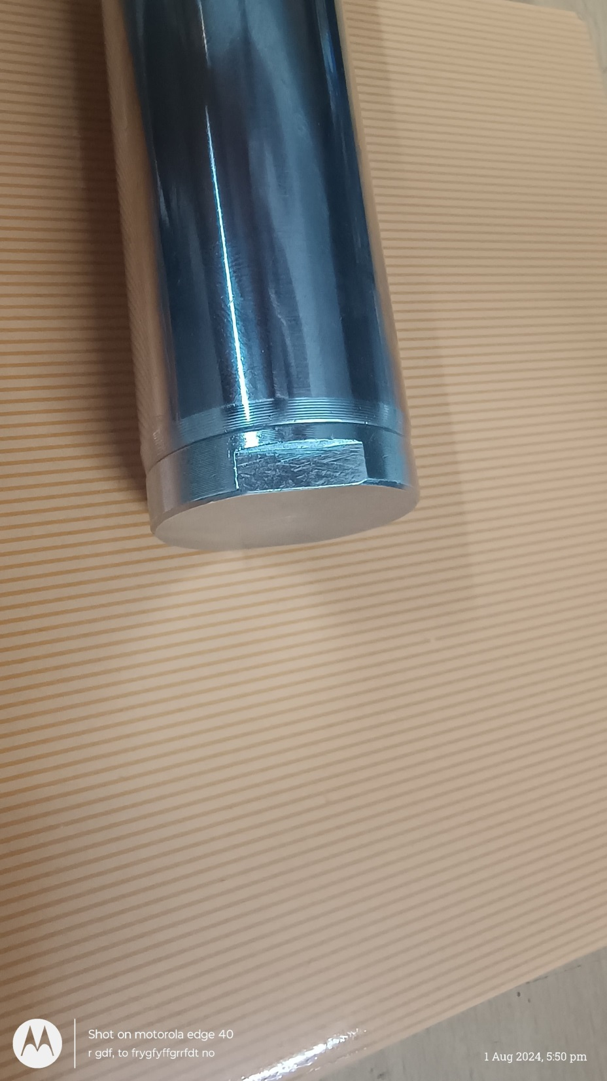
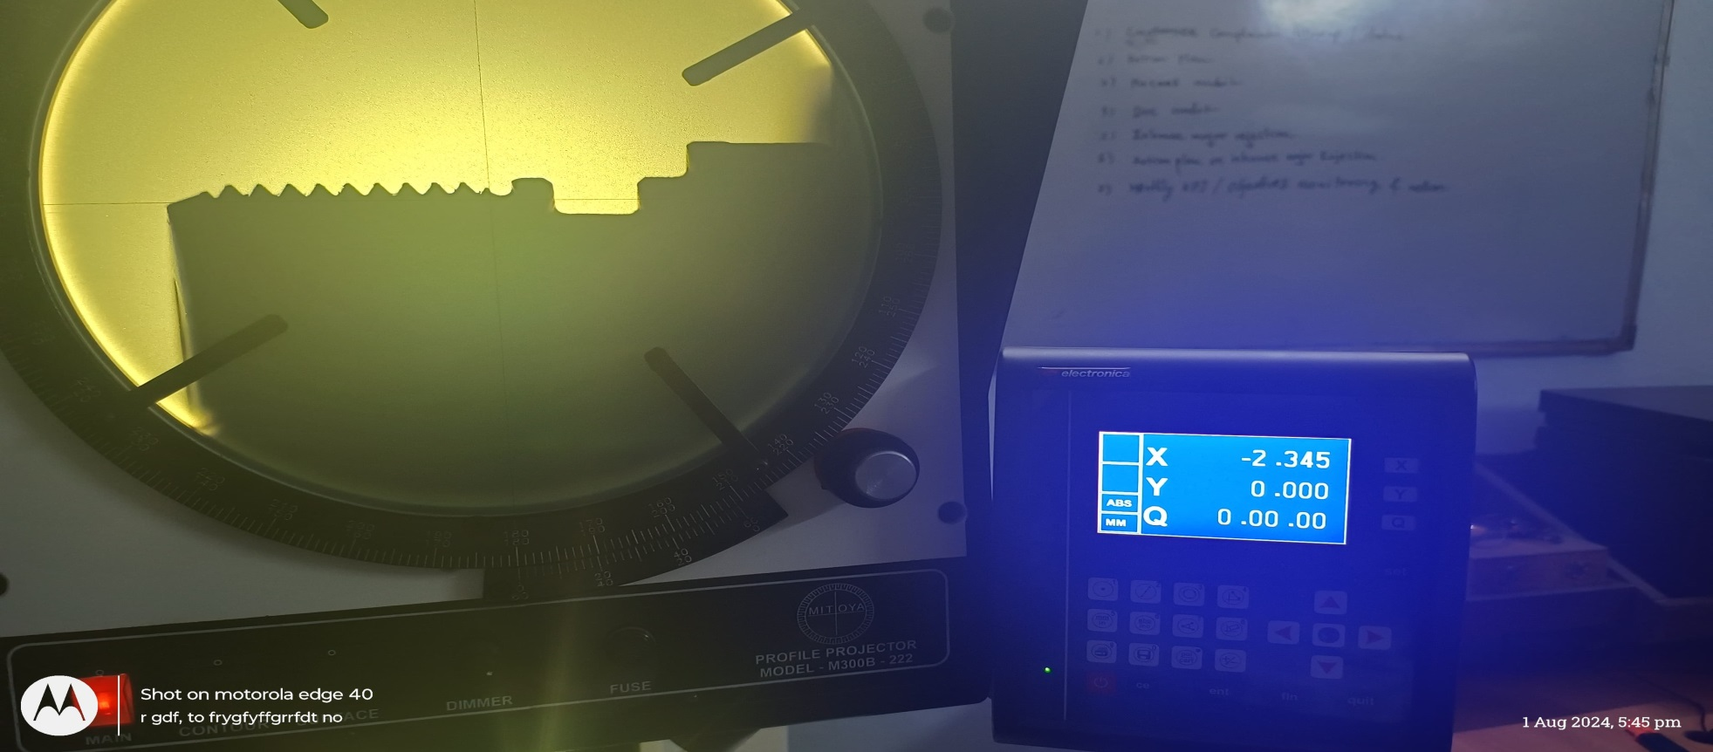
Action Plan Evidences
OCCURRENCE SIDE- AFTER
25 Nos trial have been taken and undercut size is reduced. previously it was getting above 3.0mm including Collar thickness, which is reduced to 2.50mm.

Slide 3
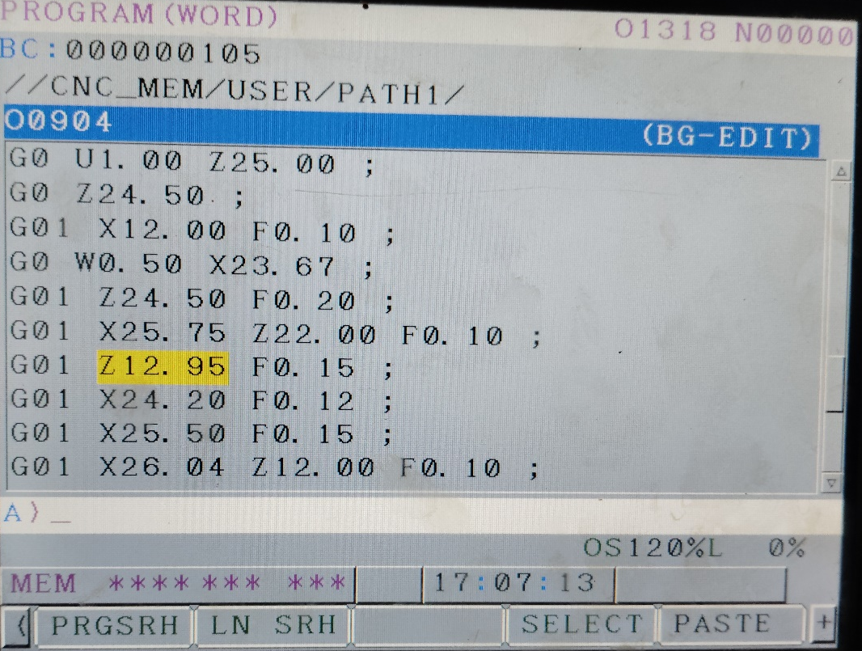
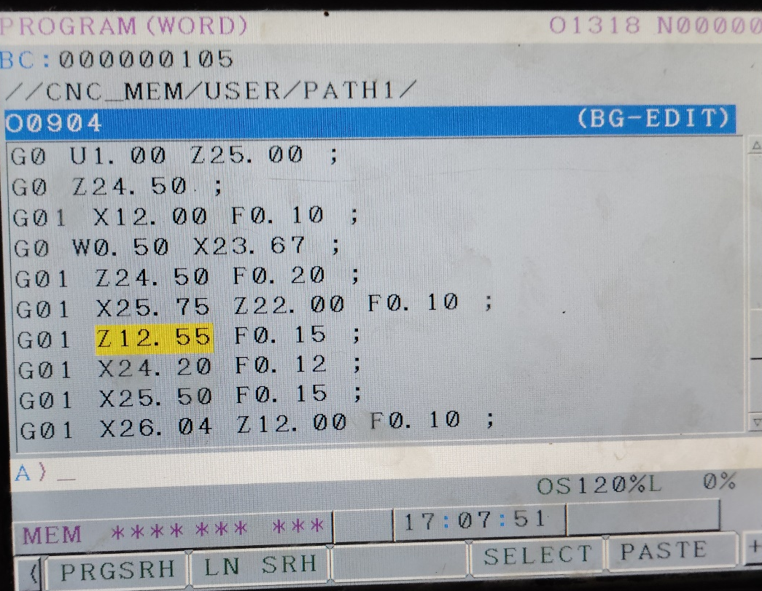
Action Plan Evidences
OCCURRENCE SIDE- AFTER
Before | After
Program Dimension reduced by 0.40

