Slide 1
Action Plan Evidences
Fork Bolt K86A-Gap in Fork Bolt and Fork Pipe.

Slide 2
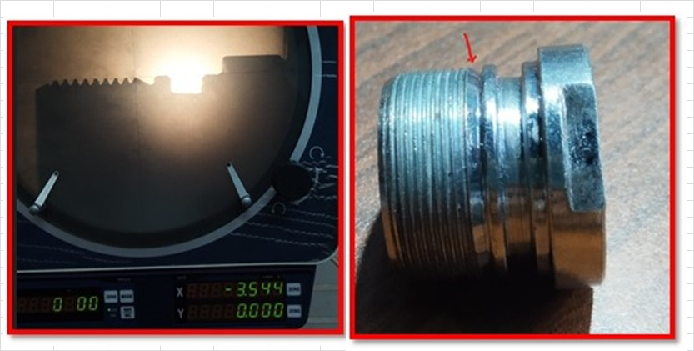
Action Plan Evidences
OCCURRENCE SIDE- BEFORE
Undercut Between the Threading & Collar is provided more.

Slide 3
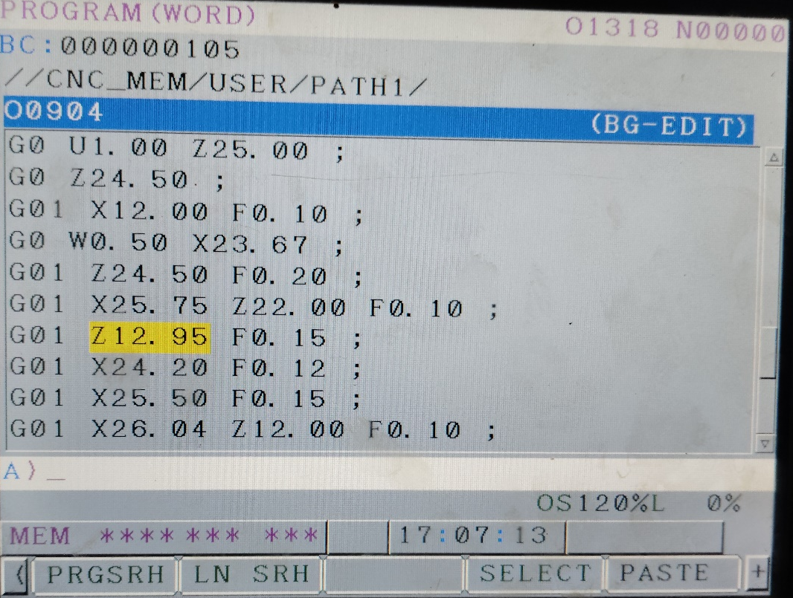
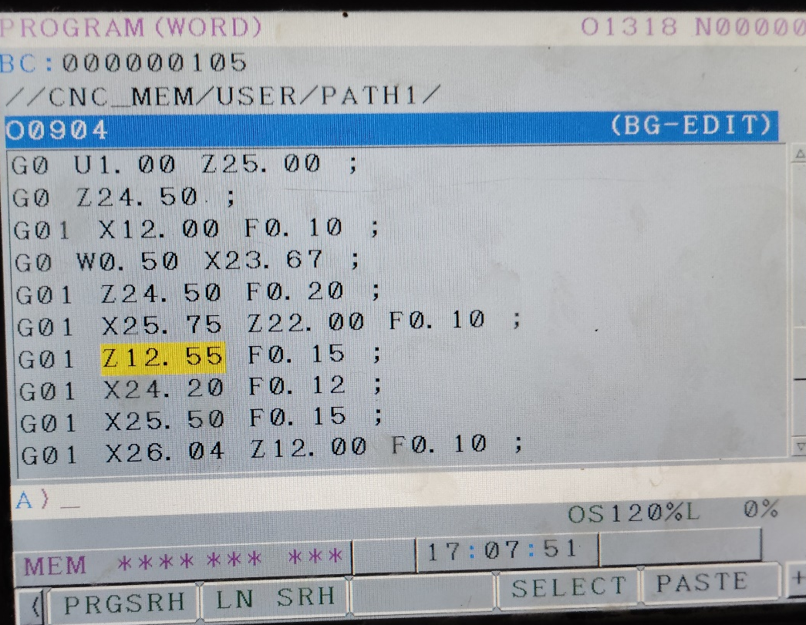
Action Plan Evidences
OCCURRENCE SIDE- AFTER
Before | After
Dimension of undercut Before

