Slide 1
Action Plan Evidences
Fork Bolt K86A-Gap in Fork Bolt and Fork Pipe.

Slide 2
Action Plan Evidences
OUTFLOW - AFTER
Bolt Conforming to Gauge up to Collar
No Gap in the Bolt and Pipe after Assembly
Training Given to Inspector and Operator to Check Part with TRG up to the Collar.

Slide 3
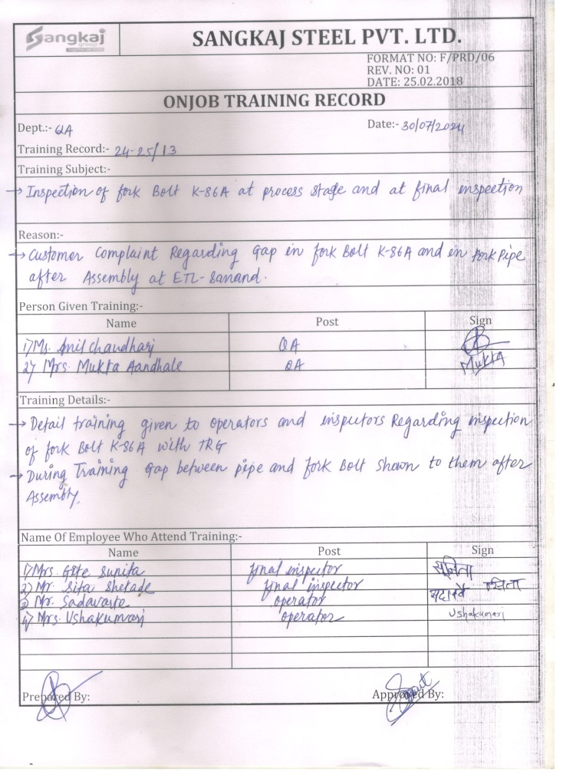
Action Plan Evidences
OUTFLOW - AFTER
Training Record

