Slide 1
Action Plan Evidences
Roughness NG in Groove - Fork Bolt K0PG

Slide 2
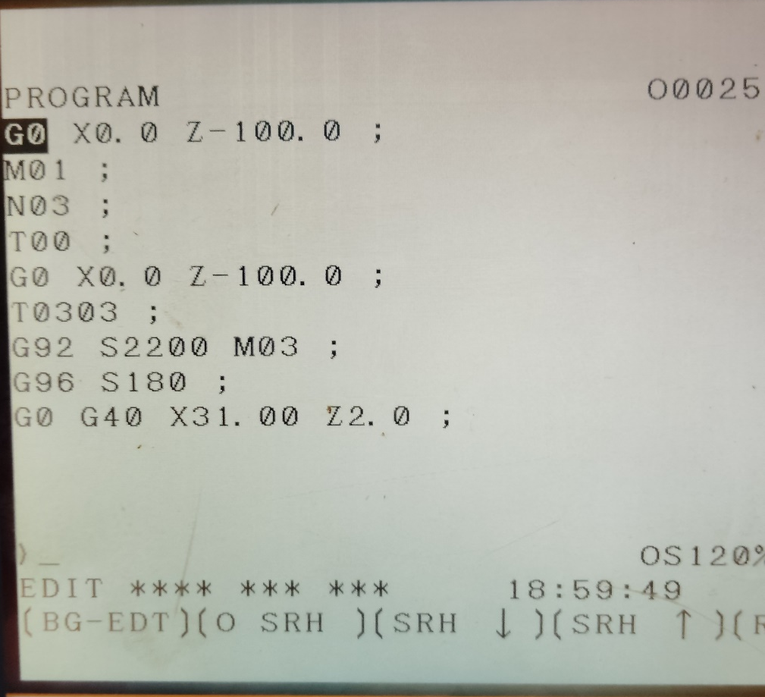
Action Plan Evidences
OCCURRENCE SIDE- AFTER
Spindle RPM
Feed
Cutting Speed
Dwell Time
Tool Life reduced from 600 No’s to 500 No’s. Also Spindle RPM, Cutting Speed & Dwell Time Increased, Feed Decreased.

Slide 3
Action Plan Evidences
OCCURRENCE SIDE- AFTER
Observed Value after

