Slide 1
Action Plan Evidences
Roughness NG in Groove - Fork Bolt K0PG

Slide 2
Action Plan Evidences
OUTFLOW - AFTER
Defect Matrix Updated, Roughness NG Defect added in Defect Matrix

Slide 3
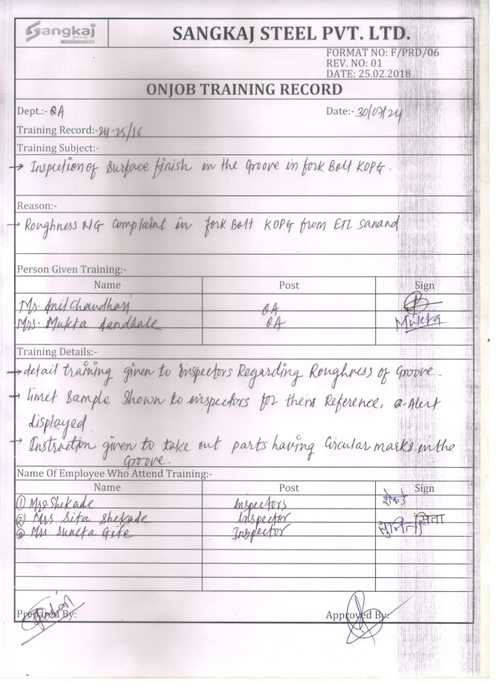
Action Plan Evidences
OUTFLOW - AFTER
Q-Alert Displayed at final Inspection
Training given to Inspectors

