Slide 1
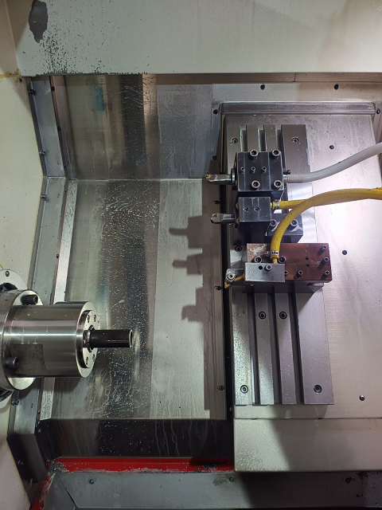
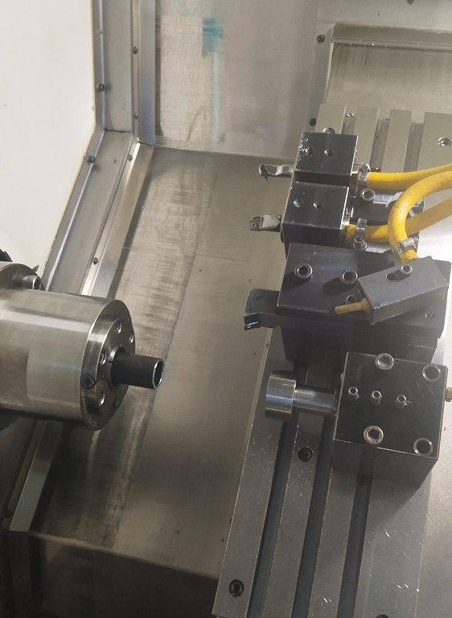
ACTION EVIDENCIES
BEFORE
AFTER
Additional Tool added
Tube come back due to Back Pressure. Operator has to Judge for resting on Stopper. No Provision to ensure
. Additional Tool added on CNC m/c Tool Head for Tube resting on Stopper.

