Slide 1
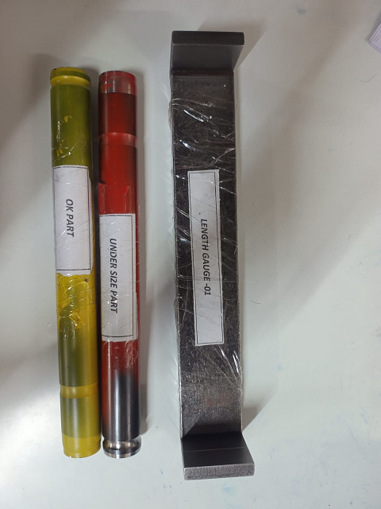
ACTION EVIDENCIES
BEFORE
AFTER
No Master samples of OK & NOT OK tube for Verification at Final Inspection.
No Master samples of OK & NOT OK tube for Verification at Final Inspection.
Master samples of OK & NOT OK tube made for Verification at Final Inspection.

