Slide 1
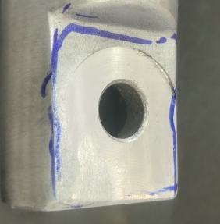
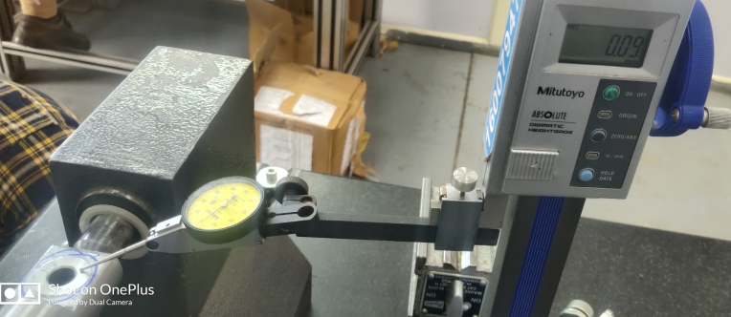
K0LA drum LH&RH buffed bottom case issues supplied by Dekson
Milling height from casting to axle face Specification- 1.5 mm Actual – 0.09 mm | Milling height less

Slide 2
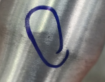
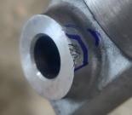
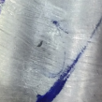
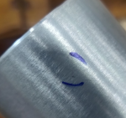
K0LA drum LH&RH buffed bottom case issues supplied by Dekson
Big dents | Big dents | Pinholes
Casting issue | Axle hole area damage | Pinhole
Pinhole | Pinhole | Pinhole

Slide 3
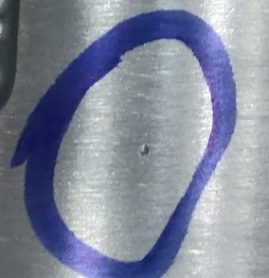
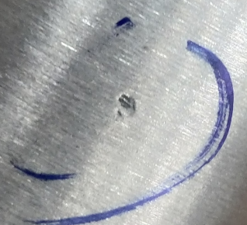
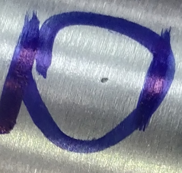
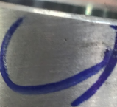
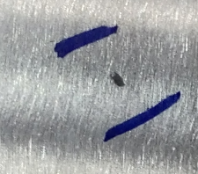
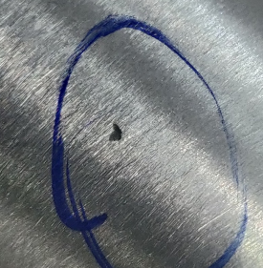
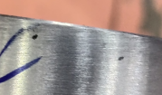
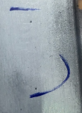
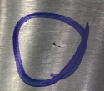
K0LA drum LH&RH buffed bottom case issues supplied by Dekson
Pinholes | Casting issues | Pinholes
Pinholes | Casting issue | Casting issue
Pinholes | Pinholes | Pinholes

Slide 4
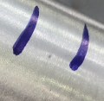
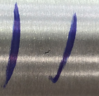
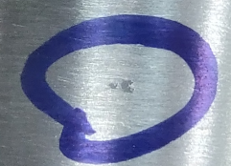
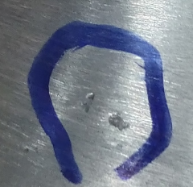
K0LA drum LH&RH buffed bottom case issues supplied by Dekson
Pinhole | Casting dent | Casting dent
Casting issue | Pinhole | Casting dent
Pinholes | Pinholes | Casting issue

Slide 5
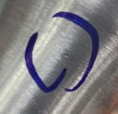
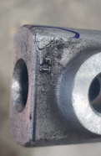
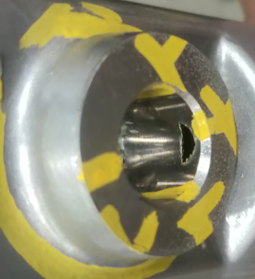
K0LA drum LH&RH buffed bottom case issues supplied by Dekson
Oil dots | Oil dots | Oil dots
Casting blow hole | Edge casting damage | Edge damage
Pinholes

