Slide 1
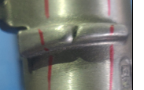
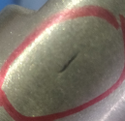
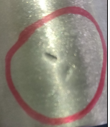
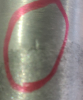
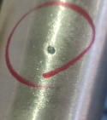
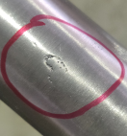
K0LA DISC LH&RH machined bottom case issues supplied by Dekson
Casting issue | Casting blow hole | Casting issue
Casting blow hole | Casting blow hole | Casting blow hole
Casting blow hole | Casting blow hole | Casting issue

Slide 2
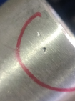
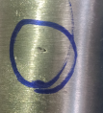
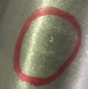
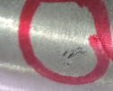
K0LA DISC LH&RH machined bottom case issues supplied by Dekson
Casting blow hole | Casting blow hole | Casting blow hole
Casting blow hole | Casting blow hole | Casting issue
Casting blow hole

