Slide 1
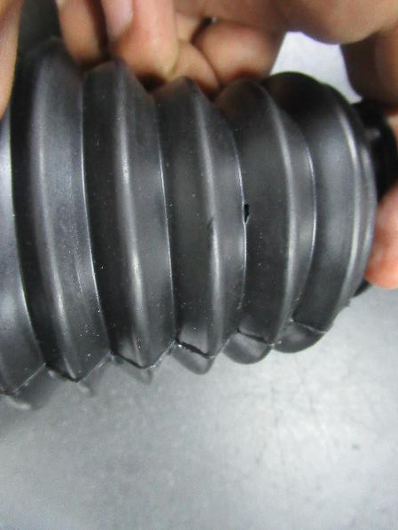
Dirt damages on bellow ABWB Model

