Slide 1
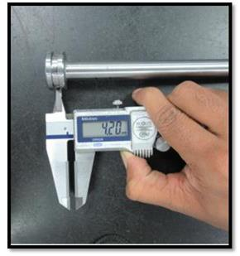
Q-issue in Seat Pipe
Piston groove with found undersize by 0.10 mm.
Required – 4.5 – 0.20 mm
Observed – 4.20 mm

